Slide 1

Crashes In Queensland 2011-2020
By Group - Canadata

Slide 2
Objective
Queensland is a state situated in northeastern Australia and is the second largest and third-most populous Australian state. Vehicle crash contributes to a significant number of deaths and injuries in this area and the objective of this project is to analyze the number of road crashes that occur in the state of Queensland every year. To proceed with the analysis, the team has gathered data from Australian government data website with respect to crashes in Queensland that is made freely available by the government of Australia for the public. The data includes information regarding location of the crashes, fatalities, Hospitalization, Medical Treatment, Minor Injuries, and characteristics for all reported Road Traffic Crashes occurred from 1 January 2001 to 31 July 2021. The dataset contains information on crashes reported to the police which resulted from the movement of at least 1 road vehicle on a road or road related area. Crashes listed in this resource have occurred on a public road and meet at least one of the following criteria,
A person is killed or injured, or
At least 1 vehicle was towed away, or
A property was damaged.

Slide 3

Problem Statement
THIS STUDY AIMS TO PROMOTE AND ELABORATE MORE ON DATA VISUALIZATION TECHNIQUES USING THE INTERACTIVE GRAPHS AND DATA DASHBOARD TO DISPLAY VEHICLE CRASH DATA. INTERACTIVE MAP AND DATA DASHBOARD CAN HELP TO DESCRIBE VEHICLE CRASH DATA BY ANSWERING THE BELOW RESEARCH QUESTIONS:
1. What’s the count of crashes in every region?
2. What’s Are the causes for the accidents?
3. Accidents By different Demographics
4.Use Of helmets and restraints
5. Severity of the crashes?
Casualties Of the Accidents.

Slide 4
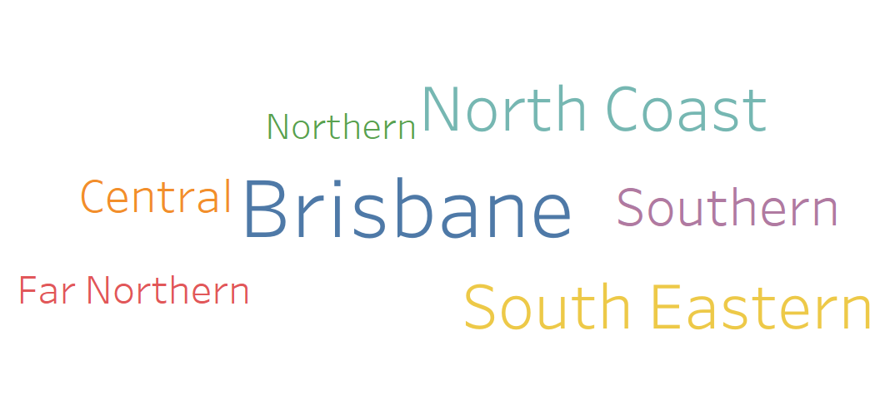
What’s the count of crashes in every region?

Slide 5
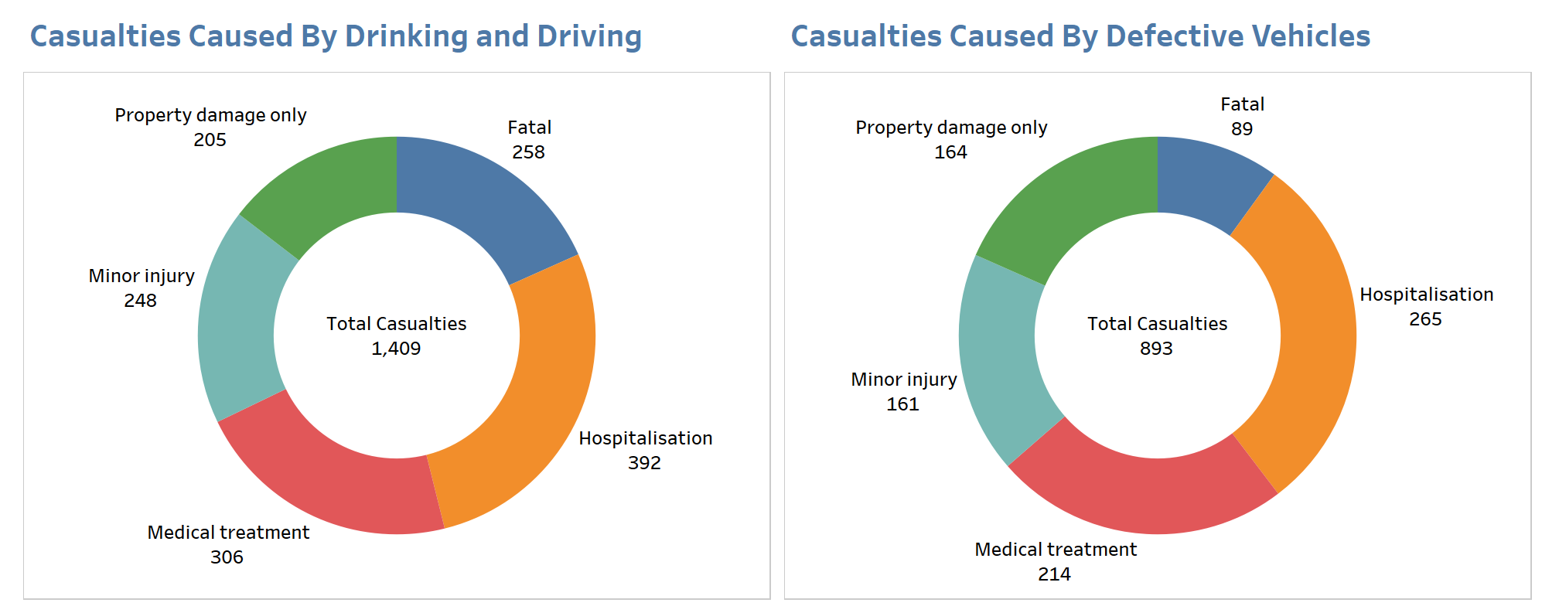
What Are the Causes for the accidents?

Slide 6
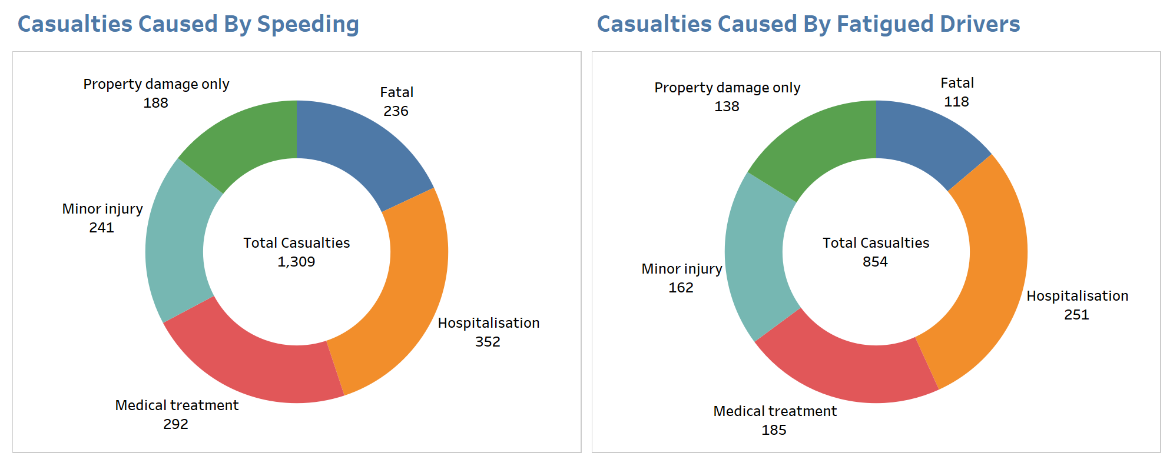
What Are the Causes for the accidents?

Slide 7
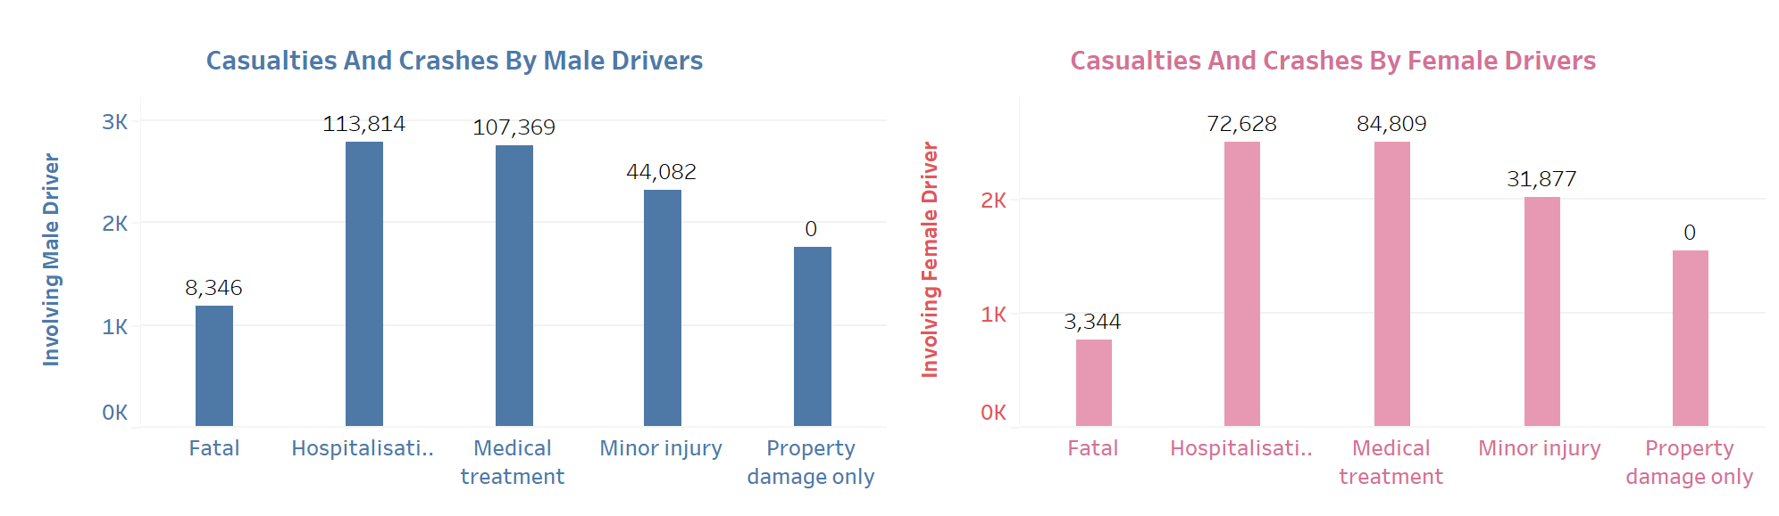
Accidents By Different Demographics

Slide 8
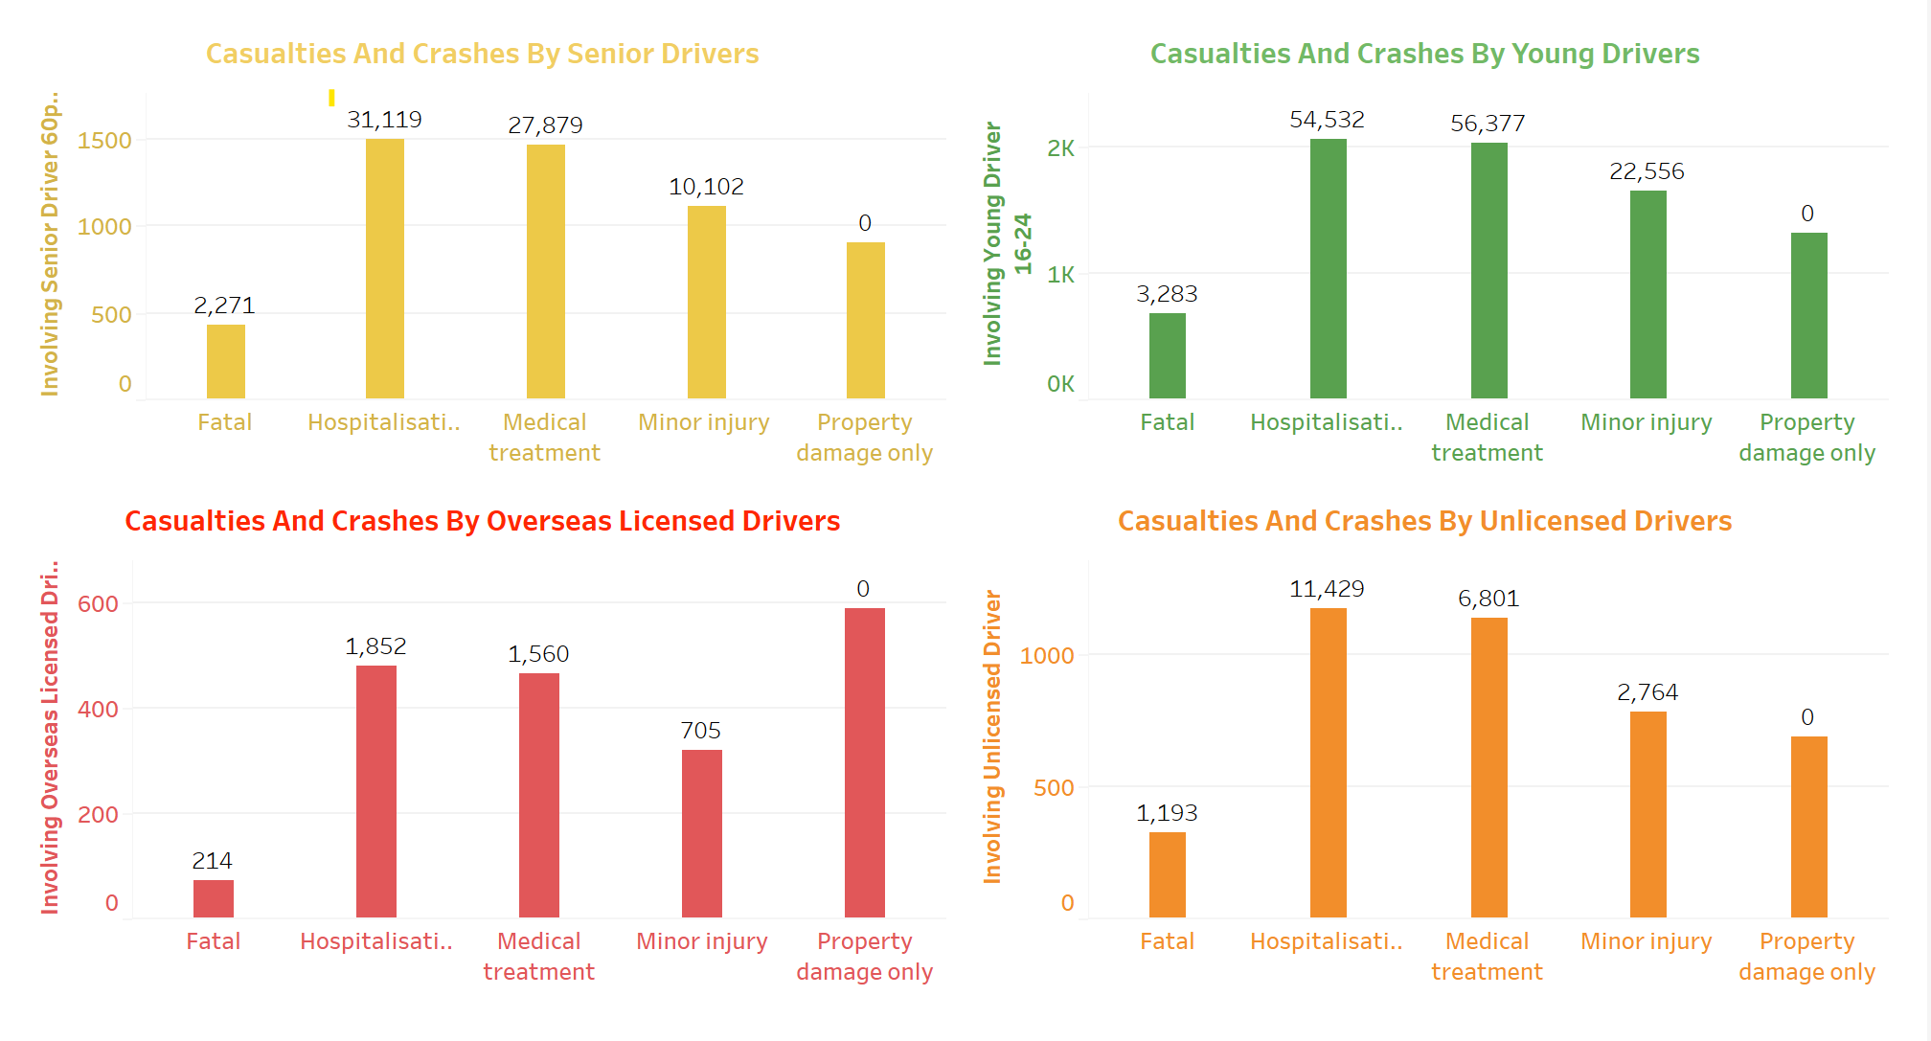

Slide 9
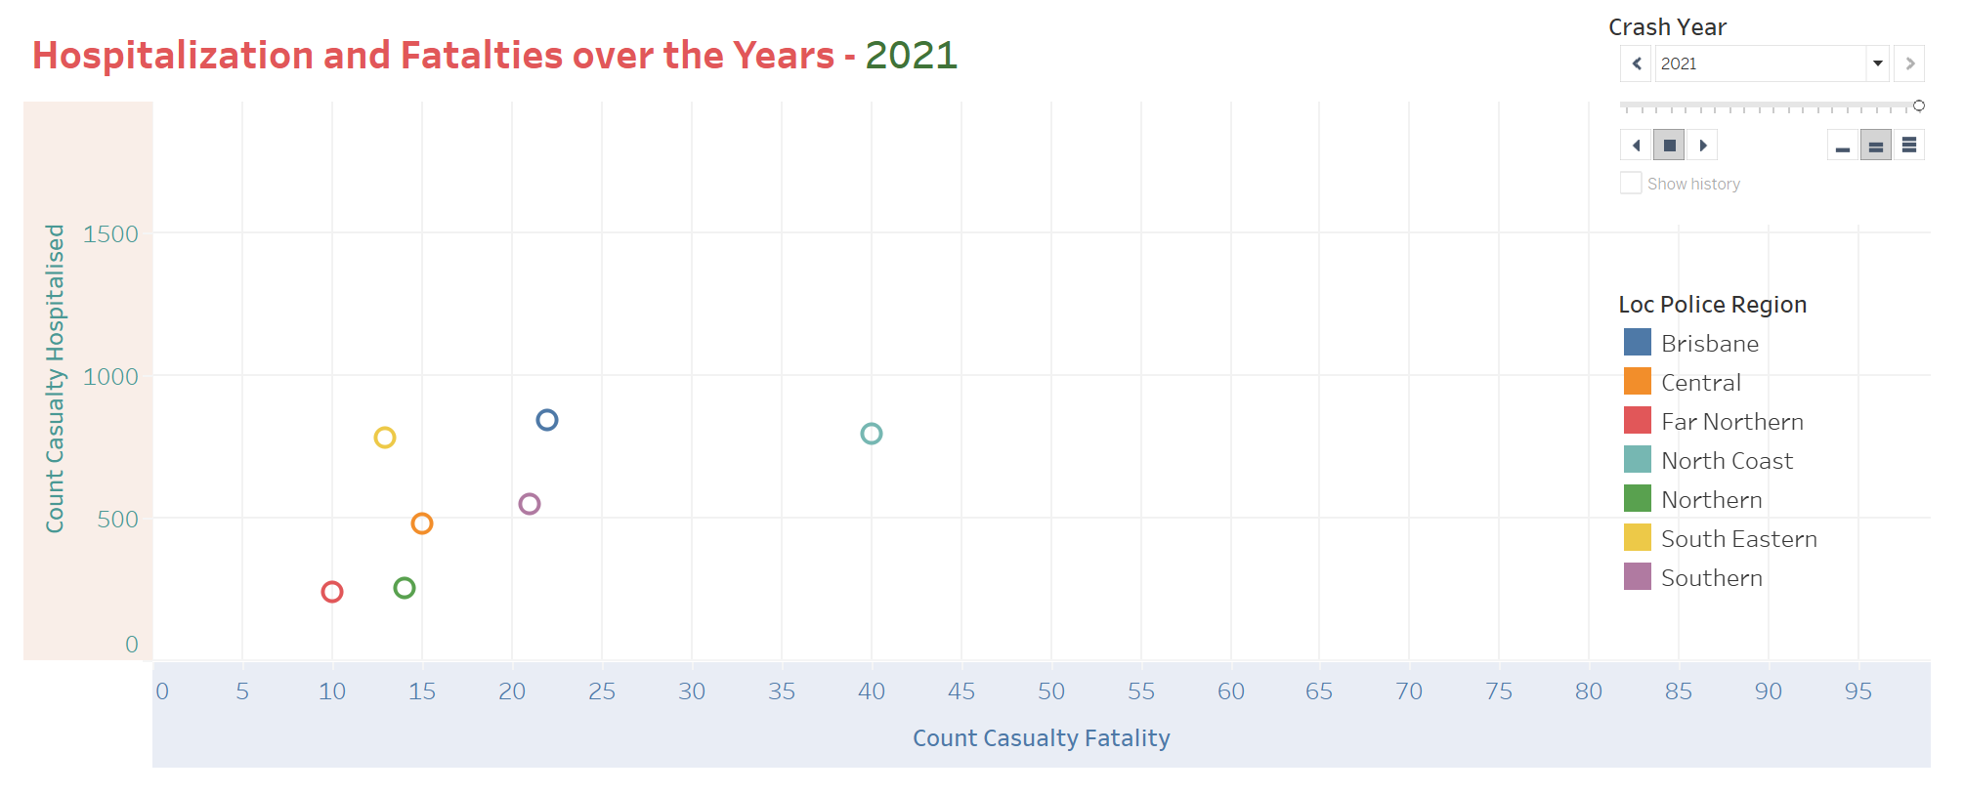
Casualties Of The Accidents

Slide 10
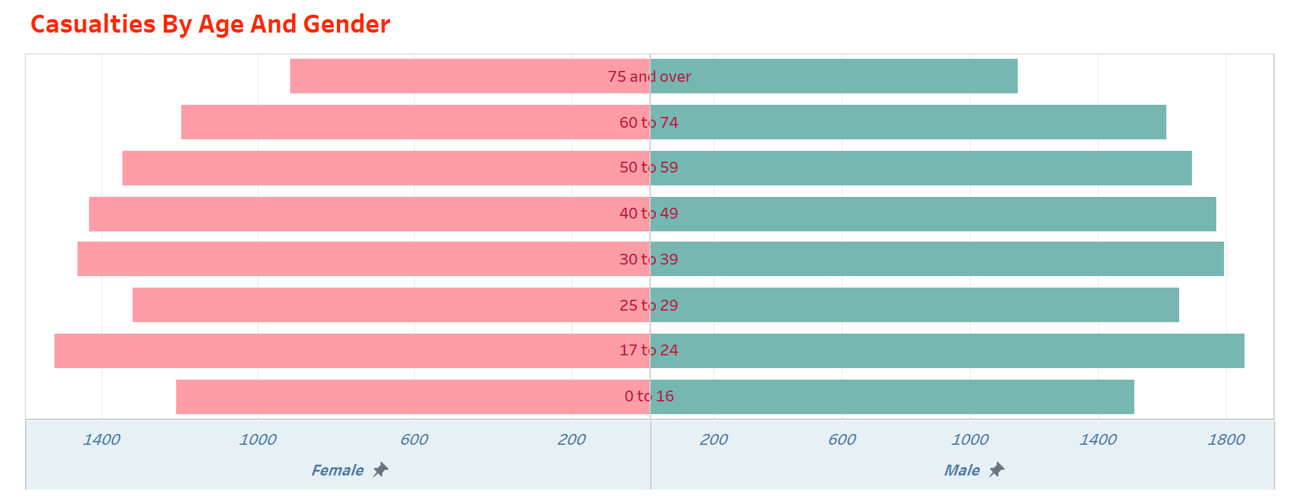

Slide 11
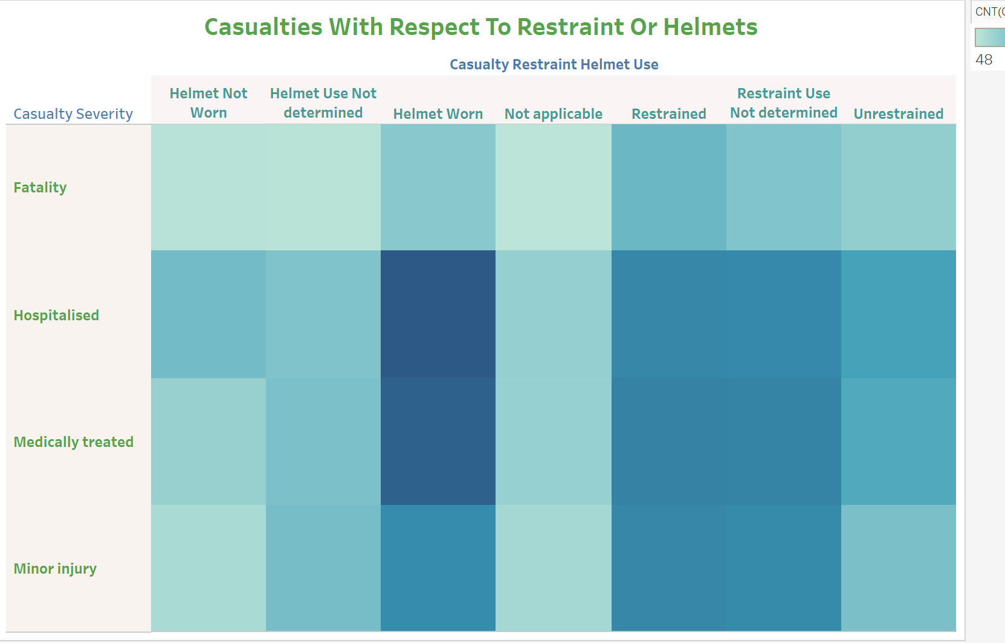
Casualties Restraint, or Helmet Use

Slide 12
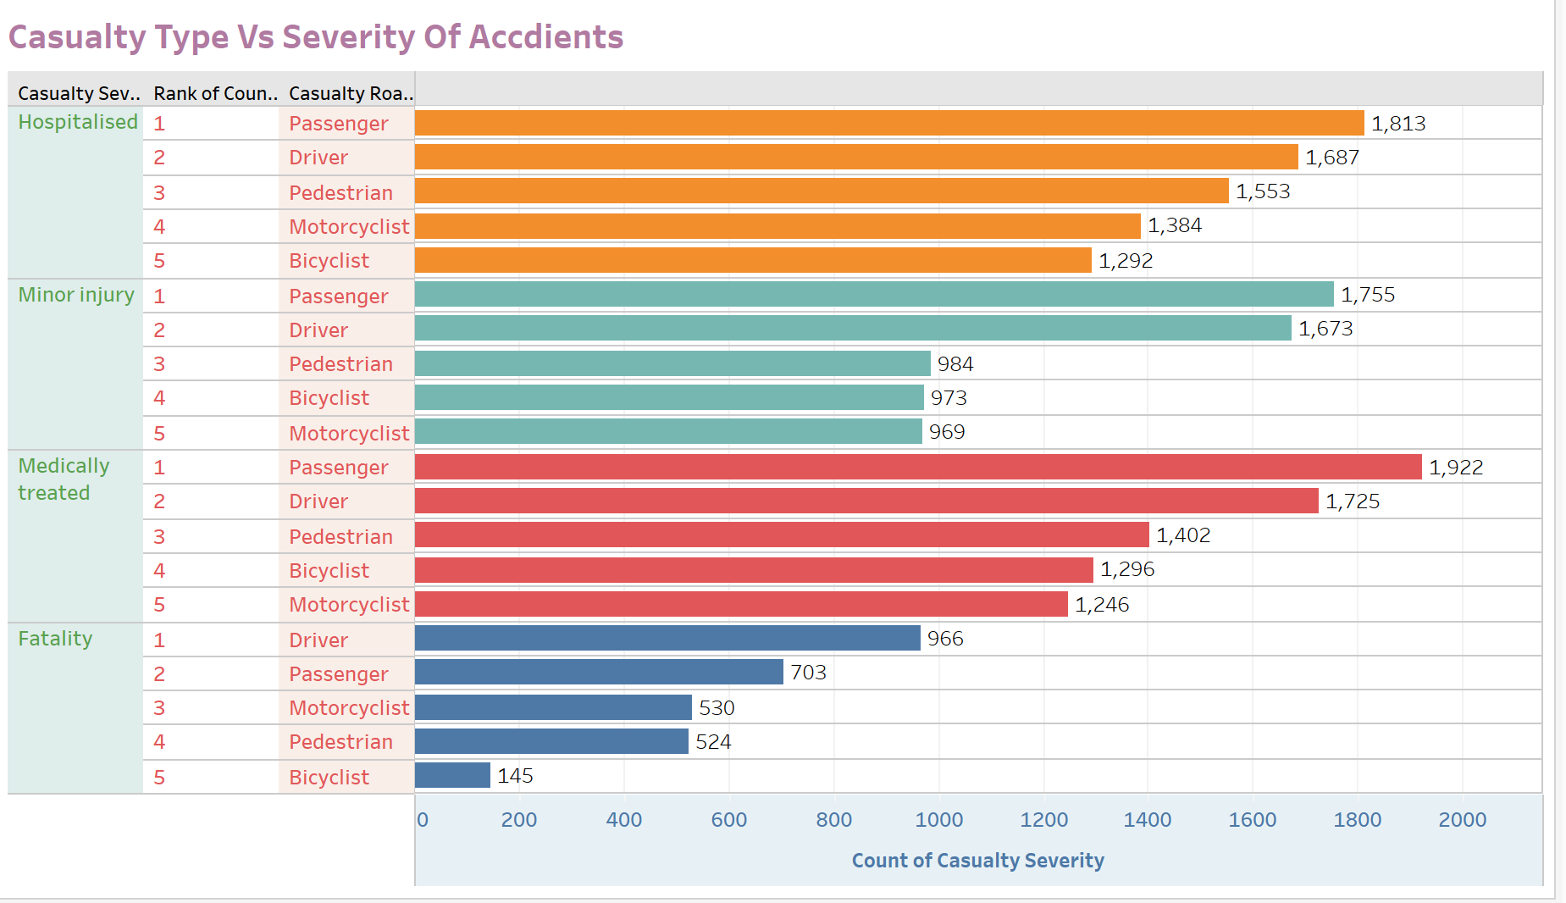
Severity Of Crashes

Slide 13
Research Topic – You are working for a company, and your IT director assigns you to do research and provide Analytics and BI Platforms for your company. How will you Choose a Platform? Review and compare five platforms

Slide 14
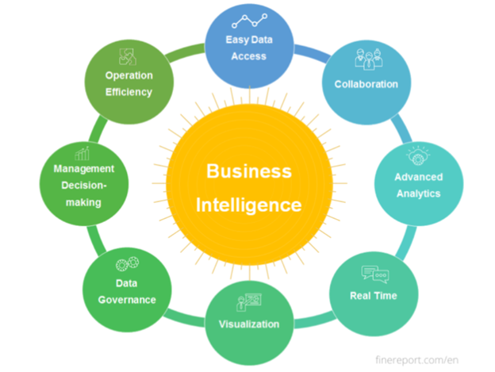
Research Topic

Slide 15
Things to consider choosing Analytics and BI Platforms
VISUAL FUNCTIONALITY & PRESENTATION
INTEGRATION
TRAINING REQUIREMENTS
PRICING
IT SUPPORT

Slide 16
Top 5 Analytics and BI tools that is popular in the market
Google Marketing Platform (Enterprise)
Microsoft Power BI
Oracle Analytics Cloud
Qlik
Tableau

Slide 17
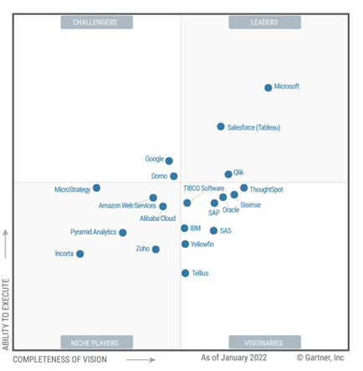
Top performers in the market

Slide 18
Top performers in the market
Of all the Analytics tools, All applications have it’s own advantages and disadvantages. The features that the application provides for the end users varies. Out of the top 5 applications, The top 2 popular and most used application in the market for analytics purposes is Microsoft Power BI and Tableau. Both the applications provide almost all the features that one need to analyze and provide valuable insights preparing reports.

Slide 19
Conclusion
The team has successfully completed the visualization of all the research questions that were intended to be analyzed for the crashes that have occurred in Queensland.
Below are some of the observations that were derived after the successful plotting of the graphs in tableau.
Brisbane city faces the highest number of crashes in the state of Queensland.
The casualties due to drinking and driving are majorly hospitalized.
Most number of property damages were caused by the defective vehicle
that crashes due to speeding have caused the highest percentage of fatalities
The age group 17 to 24 are accountable for the highest number of crashes.
there were a maximum number of hospitalizations when the accidents were caused by male drivers
The maximum number Of fatalities are amongst drivers.
The number of crashes have declined in the past decade.

Slide 20
References
Dataset:
Crash data from Queensland roads | Datasets | data.gov.au - beta

